Slide 1
Utah Fall Leadership Confernce

Slide 2
Professional Membership Benefits
WiFi: Wolverine Wifi
Public Access (no password)
Notes:
10:10-11:45

Slide 3
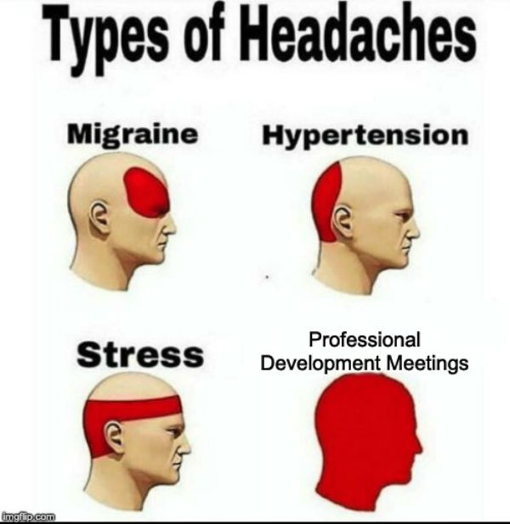

Slide 4
Professional Membership Benefits
Framework Integration Toolkit
Program of Work Toolkit
Jump into Stem
E-Courses (some are offered for students)
Advisor Professional Development, including:
Love and Logic Series
Technical Fridays
Championships Technical Standards
Notes:
Move from this slide to Absorb and skillsusa.org….as you show each tile, show the corresponding page on the website.

Slide 5
Professional Development Calendar accessible at:
https://www.skillsusa.org/events-training/
Notes:
Should I show them how to access video through connect?

Slide 6
Industry Expert Live Workshops
Notes:
Fee-based initiatives

Slide 7
Career Essentials
Instructor Version
Can access Students through Reports
Reports can be downloaded and used for grades
Admin. Account Instructions in Absorb
Career Essentials Implementation Training
Contact Megan Flinn: mflinn@skillsusa.org

Slide 8
Career Essentials
Employability Skill-Building Curricula
Exploratory: ages 12-14
Fundamental: ages 14-16
Advanced: ages 17-19
Adult Leaner: ages 20+
Demo Courses available
Discounted prices are ongoing this year
Career Essentials can be purchased with or without membership
www.careeressentials.org

Slide 9
SkillsUSA Framework

Slide 10
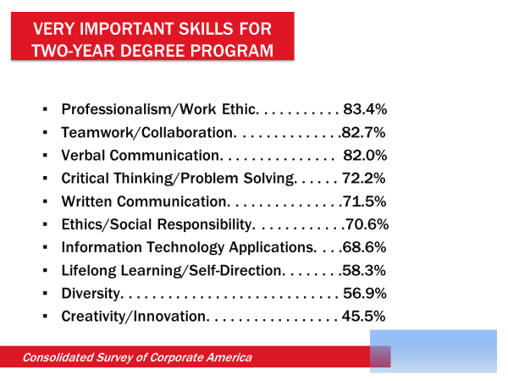
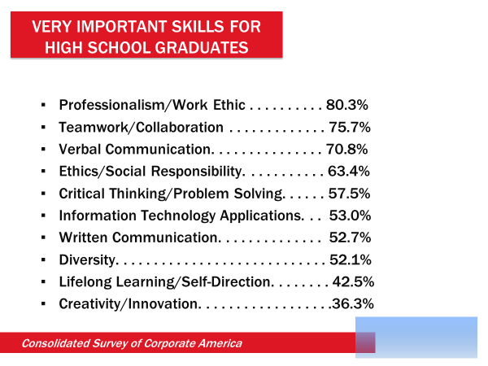
Workplace Readiness Skills
Notes:
3min
Workplace Readiness Challenge - Understanding of the problem we are working to solve through career and technical education.
A significant challenge facing America now is that employers want more emphasis on employability skills to ensure prepared workers enter their open positions.
CTE programs hold the key to unlock this challenge.

Slide 11
SkillsUSA Framework Resources
Framework Integration Toolkit
Housed in Absorb as a Professional Membership Benefit
Scripted Lesson Plans for each Essential Element
Experiential Activities
Framework Story Lesson Plans
Games, Videos, and More

Slide 12
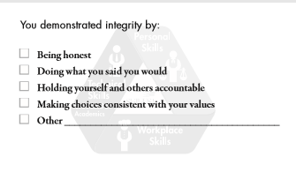
Framework Resources found in the store

Slide 13
Establishing a Framework Culture
Group Work Assignment:
Each group will be assigned one of the 5 Strategies outlined in the book
On flipcharts:
Basics of that Strategy
Top Three Ideas
Please plan to briefly present ideas found on flipcharts
Notes:
Hide this slide unless you are giving away this resource and using it.

Slide 15
Please fill out the Evaluation!

Slide 16
SkillsUSA Framework Integration
Wifi: Wolverine Wifi
Public Access (no password)
Notes:
12:55-2:25pm…start with Betty Boop, p. 39 of Jump Start 2.0
4:30-5:30 Absorb course

Slide 17
SkillsUSA Framework

Slide 18
Workplace Readiness Skills
Notes:
3min
Workplace Readiness Challenge - Understanding of the problem we are working to solve through career and technical education.
A significant challenge facing America now is that employers want more emphasis on employability skills to ensure prepared workers enter their open positions.
CTE programs hold the key to unlock this challenge.

Slide 19
Step 1: Target an Essential Element
I write and speak effectively.
I use appropriate body language.
I check for understanding when discussing difficult topics.
I listen carefully.
I ask good questions when needed.

Slide 20
Step 2: Integrate the EE into classroom, lab, and chapter activites.
Classroom Experiences:
How can you integrate an EE into your regular classroom instruction?
Notes:
Table discussions, and then add to the next slide as they come up with ideas.

Slide 21
Step 2: Integrate the EE into classroom, lab, and chapter activities.
Let’s Share Ideas!
How can you integrate an EE into your regular classroom instruction?
Use of Framework toolkit
Answer questions with questions
Process of communication prior to seeking advisor (design process)
Video examples of appropriate body language (in interviews)
Repeat a name after an introduction
Eye Contact
How to Talk (volume, tone, pronounciation)
Timing/Tact
Text to English language writing assignment

Slide 22
Step 2: Integrate the EE into classroom, lab, and chapter activites.
Revise this memo to make it more clear and direct:
“Due to the fact that next Wednesday following Tuesday is the day before Christmas, the normal work day will be shortened for the purpose of allowing employees to join their respective families in celebration of the holiday.”

Slide 23
Step 2: Integrate the EE into classroom, lab, and chapter activites.
Write a professional response to this comment that appeared on your restaurant’s social media page:
“Really horrible pumpkin pie on Thanksgiving! The whole meal was terrible, and the one thing I thought would be good was the worst part. Thanks for ruining my holiday! I would rather give my money to the homeless person outside the front door than waste it on an awful meal again.”

Slide 24
Step 2: Integrate the EE into classroom, lab, and chapter activites.
Lab Experiences:
How can you integrate an EE into your lab experiences?
Notes:
Table discussions, and then add to the next slide as they come up with ideas.

Slide 25
Step 2: Integrate the EE into classroom, lab, and chapter activites.
Let’s Share Ideas!
How can you integrate an EE into your lab experiences?
Ideas on a white board that focus on the EE
Students explain the lab task
Conceptual ideas put on paper (technical communication)
Leadership roles in the lab
Ambassador roles: 30 Second Elevator Speech: what is SkillsUSA?

Slide 26
Step 2: Integrate the EE into classroom, lab, and chapter activites.
Class Discussion: What does communication look like when we’re in the lab?
Create a rubric of the above list.
Give praise and feedback based on the above list.
Resource: SkillsUSA Framework Integration Strategies (Absorb)

Slide 27
Step 2: Integrate the EE into classroom, lab, and chapter activites.
Chapter Meetings:
How can you integrate an EE into your Chapter Meetings?
Notes:
Table discussions, and then add to the next slide as they come up with ideas.

Slide 28
Step 2: Integrate the EE into classroom, lab, and chapter activites.
Let’s Share Ideas!
How can you integrate an EE into your chapter meetings?

Slide 29
Step 2: Integrate the EE into classroom, lab, and chapter activites.
Framework Lesson Plans
Framework Motion Graphics
Experiential Activities
Other Teambuilders/Icebreakers
Resource: SkillsUSA Framework Toolkit components in Absorb
Notes:
Professional 4 Corners, p. 74/75 and What’s on Your phone p. 20…point out lesson plan

Slide 30
Step 3: Assess the EE again
I write and speak effectively.
I use appropriate body language.
I check for understanding when discussing difficult topics.
I listen carefully.
I ask good questions when needed.

Slide 31
Step 4: Celebrate and Achieve Recognition
Framework Story Potluck Day
Framework Friday: Team Recognition using Framework language
Chapter Excellence Program application

Slide 32
Chapter Excellence Program
Notes:
Welcome attendees…ask for that they already know about CEP as they introduce themselves.

Slide 33
What is the Chapter Excellence Program?
Chapter Excellence Program
Info on the SkillsUSA website
Notes:
Show the video (4 minutes) and guide them to the CEP page on the webpage. Explain that there are all kinds of resources on this page and that we will be pointing them out as we move through the session.

Slide 34
Notes:
Do a quick knowledge check to ensure that attendees have some knowledge of the Framework….if you need to do a quick explanation of the Framework and how to integrate, take some time to do that now. Explain that the Framework is integrated through chapter activities and these are highlighted in the CEP application.

Slide 35
The Basics
What is it:
Recognition of chapter achievement in integration of SkillsUSA Framework in Program of Work activities
Why do it:
Application and development of Framework skills
Leadership Development
State and National Recognition

Slide 36
Notes:
These are the levels…go through them from the bottom up. Make sure they understand that this training really focuses on Level 1 and 2, but that any chapter can move higher on the levels based on their application scores. If they are brand new, if they achieve Level 1 and/or 2, that is a great start!

Slide 37
Level 1 Quality Chapter Award Requirements
Pay membership dues
All section advisors pay professional dues to SkillsUSA
Elect chapter officers
Conduct well planned, regularly scheduled chapter meetings
Complete a projected chapter budget
Complete a program of work
Conduct at least one activity within each of the three framework components: Personal skills, workplace skills and technical skills
Complete the Level 1 Quality Chapter application
Notes:
Point them to the “Download the CEP application template” link (right above the video on the CEP page) so they can see visually. Tell them that this template is a great rough draft for them to use to map out the activities that they will highlight in the application.

Slide 38
Notes:
Note: Level 1 requirements are very simple checkmarks and fill in the blank. You could start filling it out as we go through the session. Go to skillsusa-register.org, log in, and find the CEP area on the home page.

Slide 39
Notes:
In Level 1, you only have to list three activities in each Framework area; you don’t have to explain them or go into detail. So, save the activities where the Framework was really integrated for Level 2. You can’t use the same ones again. Give examples. Also, only check 1-2 Essential Elements for each Framework area, even if multiple are addressed. Stop here for questions/concerns/help. Review that if they are brand new, they may want to stop here and call it good. They will get an email after they submit saying they have earned High Quality and they can then move on to Level 2 or not. Always their choice.

Slide 40
Level 2 Chapter of Distinction Requirements
Conduct chapter officer training
Conduct a chapter recruitment activity
Engage members in committees
Prepare to participate in State Leadership and Skills Conference
Complete at least 7 of 14 Chapter Distinction indicators

Slide 41
Chapter Distinction Indicators
75% of eligible students are SkillsUSA members
Hold executive committee meetings with local chapter officers
Conduct an activity to engage business and industry partners
Students attend Fall Leadership Conference
Chapter members attend one activity above the chapter level excluding Fall Leadership Conference
Present a report of chapter activities and accomplishments to the school board
Hold SkillsUSA local technical area Championships
Hold SkillsUSA local leadership/occupational area Championships
Celebrate SkillsUSA Week through chapter activities
Publish one of more articles in local media
Provide a social media or web presence for your local chapter
Have a candidate for state office
Conduct chapter awards program or banquet on the local level, in which all members may attend
Participate in the Career Essentials: Experiences
Complete and record three Chapter Activities
Notes:
This section of Level 2 is again check marks. This is a list to aspire to, so don’t worry if not all of the categories are checked. Notice that you must check 7 to achieve Level 2; if you aren’t there yet, use this list to help plan for next year’s Program of Work.

Slide 42
Notes:
Now you will highlight three NEW activities that show integration of Framework skills. In this section, you will write SMART goals, describe the activity and its timeline, and share the results of the SMART goals (even if you don’t achieve them…all part of learning). Again, only focus on 1-2 Essential Elements. You will also share a picture that shows your students in action.

Slide 44
Write SMART Goals for Activities
The Drive-Thru Veterans Appreciation breakfast on November 11, 2020, will serve 100 community members.
All students, 100%, who participate in the Christmas tree sales fundraiser will demonstrate at least three customer service skills as outlined in the activity handbook and assessed by peer review by the end of the sale period, December 23, 2020.
Notes:
If you’re not sure what a SMART goal is, here it is. There are also SMART goal resources and lesson plans on the CEP page (point out where).

Slide 45
Notes:
Review the levels and remind them that this is a great recognition opportunity and well worth doing, but that as new advisors, they are not expected to achieve all levels right away. (although some new advisors have achieved MOE level their first year) Remind them of the Kelli coaching sessions and show where to find those. Even if they want help with Level 1 or 2, she is there. Remind them that CCT can also help them wade through the application, but not necessarily help them formulate SMART goals like Kelli can.

Slide 46
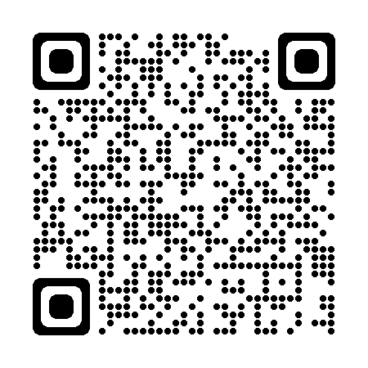
Thank You! Please fill out our evaluation!
Notes:
Attach a new evaluation

Slide 51
Thank you for your Time!

